Slide 1







WAN Mode Server must have a fixed DNS name.
Perfect for Internet deployments.
LAN Mode No fixed server IP or name.
Perfect for local networks.
Hybrid Mode Both LAN and WAN mode.

Slide 2

MeshCentral
Agent Device Group
LAN, WAN, Hybrid
MeshAgent
Intel® AMT
MeshCentral
Intel® AMT Device Group
LAN, WAN , Hybrid
Intel® AMT
MeshCentral
Local Device Group
LAN , Hybrid
Applications

Slide 3

MeshCentral
Agent Device Group
LAN, WAN, Hybrid
MeshAgent
Intel® AMT
MeshCentral
Intel® AMT Device Group
LAN, WAN , Hybrid
Intel® AMT
MeshCentral
Optional Relay
Local Device Group
LAN , Hybrid, WAN
Applications

Slide 4
SSH, FTP, VNC
RDP
SSH, FTP, VNC
RDP
MeshAgent as Relay

Slide 5
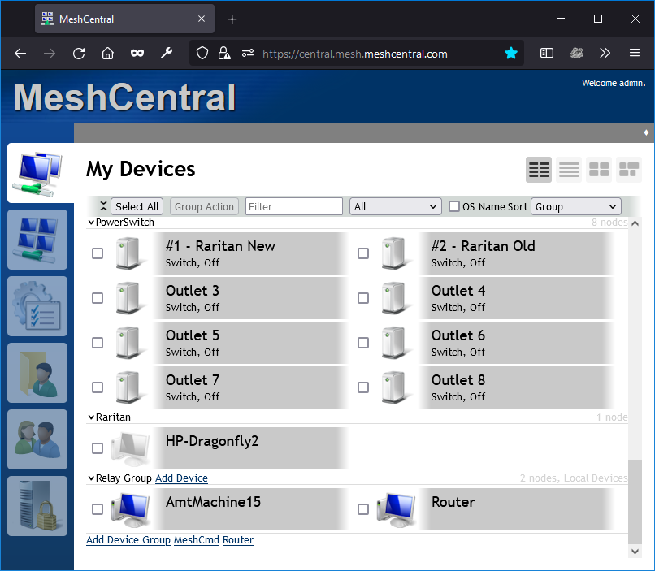
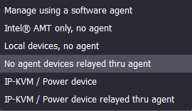
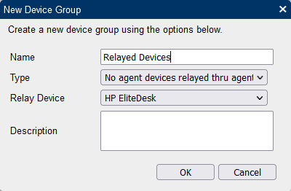

Slide 6
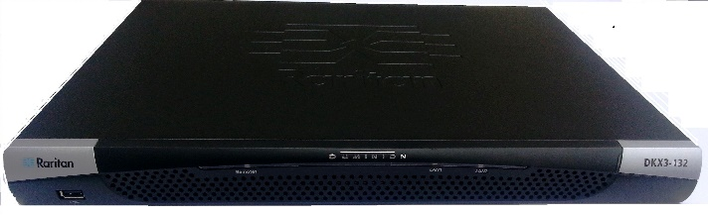

Relay
MeshCentral
{
"domains": {
"": {
"ipkvm": true
]
}
}

Slide 7
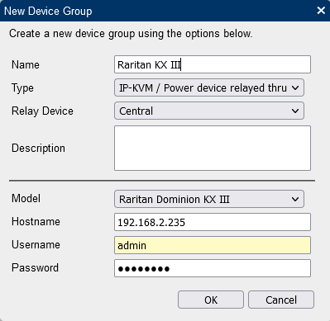
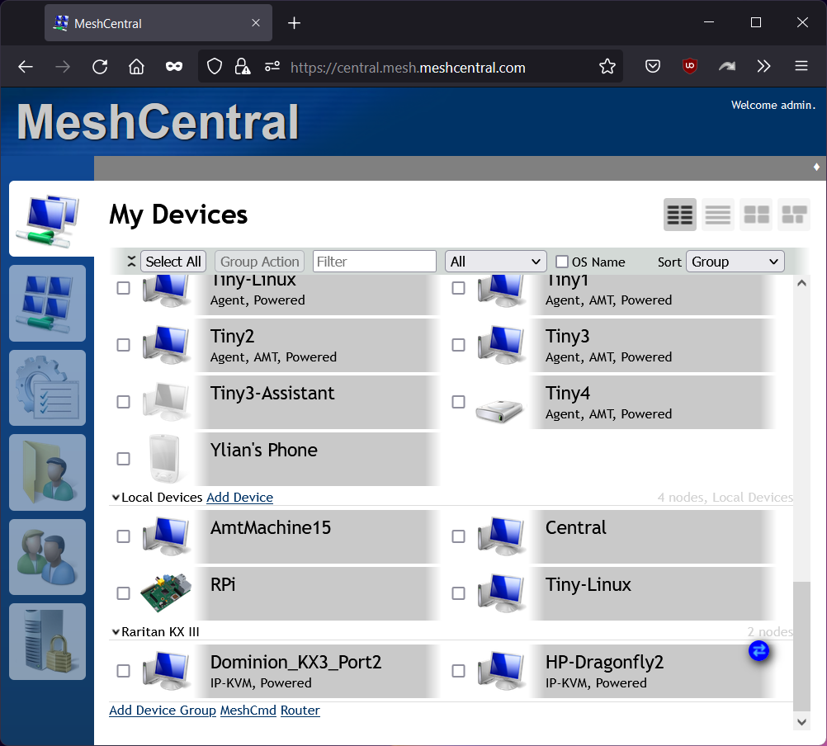
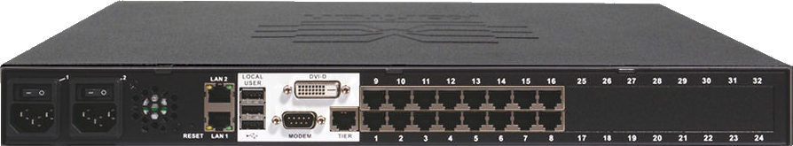
Raritan KX III

Slide 8
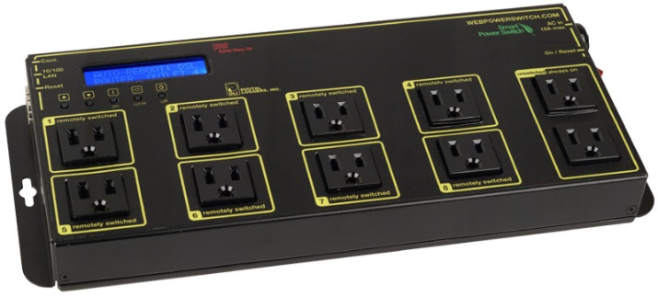
Relay
MeshCentral
Web Power Switch
{
"domains": {
"": {
"ipkvm": true
]
}
}

Slide 9
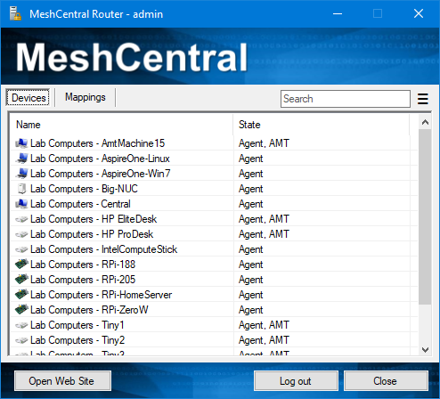
MeshCentral
Server
MeshAgent
MeshCentral
Applications

